Slide 1
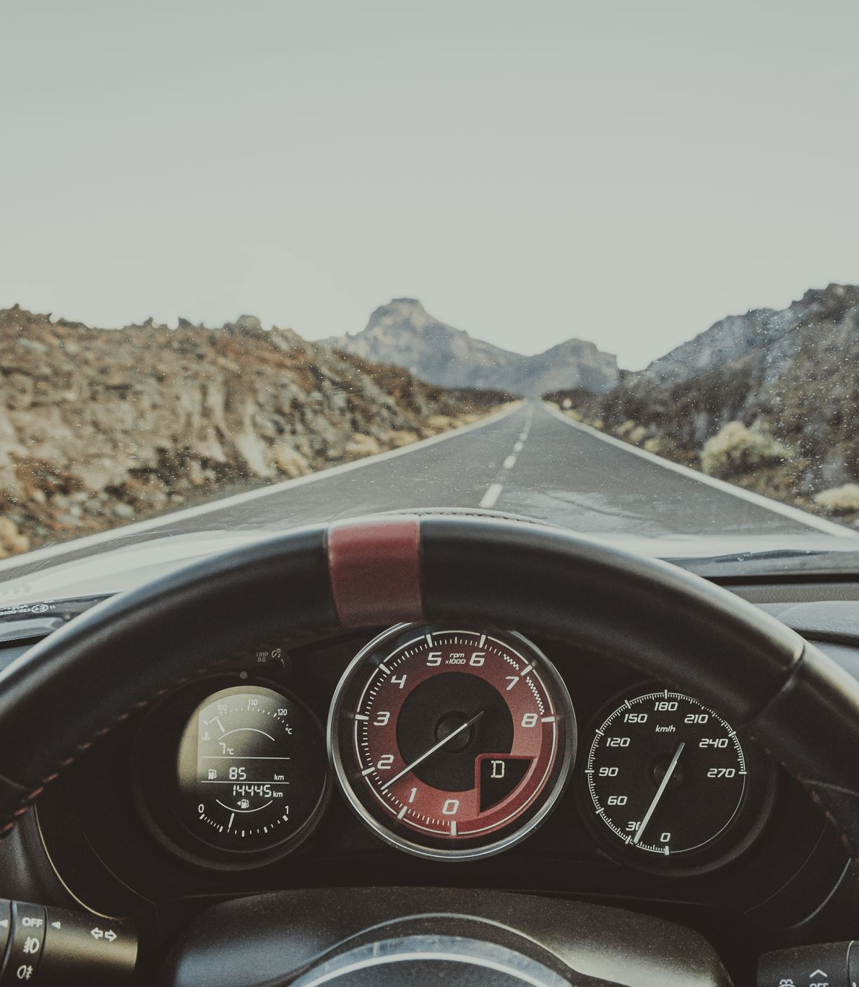
DRIVER DROWSINESS DETECTION SYSTEM
Team 11
Nihaas Reddy R – AM.EN.U4CSE20157
Dheeraj Reddy B – AM.EN.U4CSE20115
Karthik P M – AM.EN.U4CSE20138
Vamsi Narayanan – AM.EN.U4CSE20146

Slide 2
Problem Statement
Driver drowsiness and fatigue are significant causes of road accidents.
Every year, they increase the number of deaths and fatalities worldwide.
A module for an advanced driver assistance system is presented in this system to reduce the number of accidents caused by driver fatigue and thus increase transportation safety.
This system deals with automatic driver drowsiness detection based on visual information and Artificial Intelligence.
The proposed OpenCV algorithms effectively find and help to normalize human faces helping in detecting whether the person is feeling drowsy.
Several faces and body gestures, including tiredness in the eyes and yawning, are regarded as signs of drowsiness and fatigue in drivers. These characteristics indicate that the driver’s condition is poor.

Slide 3
Currently used driver fatigue detection systems
One of the examples of a system detecting a driver’s fatigue is the system
implemented into the Driver Assistant in Ford cars. It analyses rapid steering movements, driving onto lines separating lanes, irregular and rapid braking or acceleration.
Skoda cars use a similar system. It analyses the steering
movements and compares them to the movements in normal driving.
Volkswagen uses the Bosch Driver Drowsiness Detection
It also analyses how a car behaves on the road. Based on the information
from the power assisted steering sensor and the steering angle sensor, the system detects sudden changes in the trajectory of the vehicle, which translates into driver’s fatigue.
Such a solution allows detecting a fatigue at the operator of the vehicle.

Slide 4

Innovation
However, these sensors had limitations and were not always accurate.
We are trying to do a vision-based system with machine learning algorithms which can detect the drooping eyelids, head movements etc.
With an alert sound upon detection.
System also detects whether the driver is using phone while driving.

Slide 5

Methodology
Diagram

Slide 6
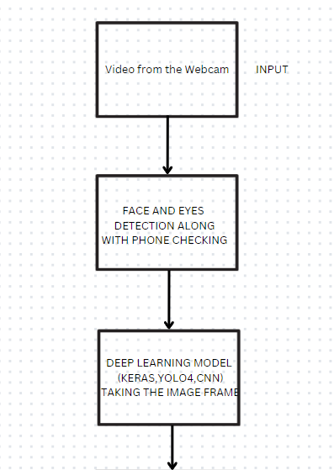
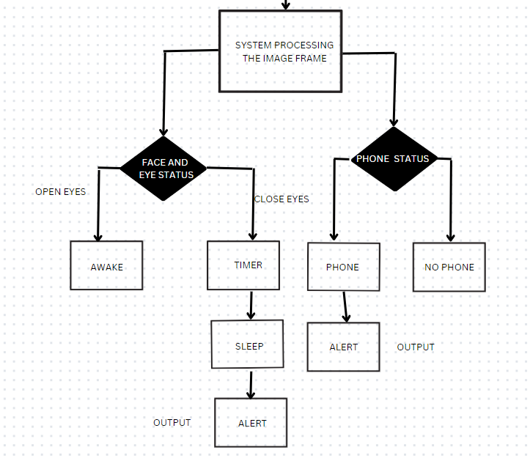

Slide 7

Dataset (images): DRIVER_DROWSINESS_DETECTION_DATASET

Slide 8
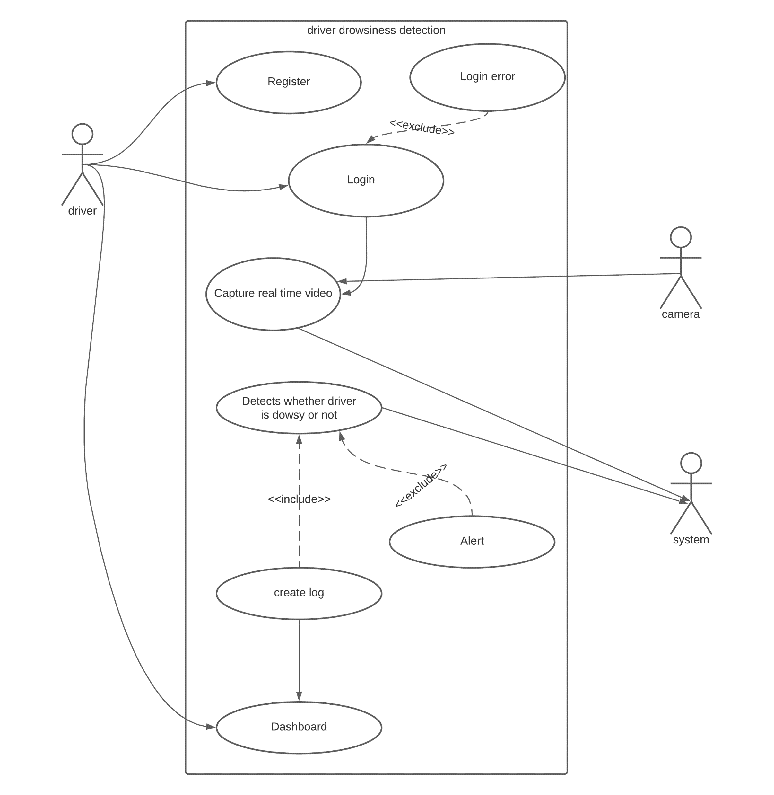
Use case Diagram

Slide 9
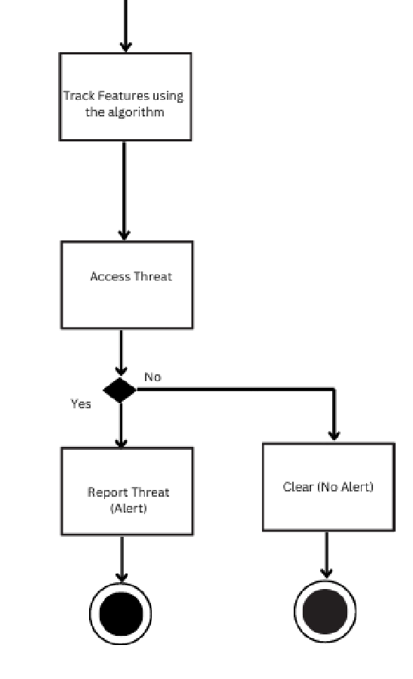
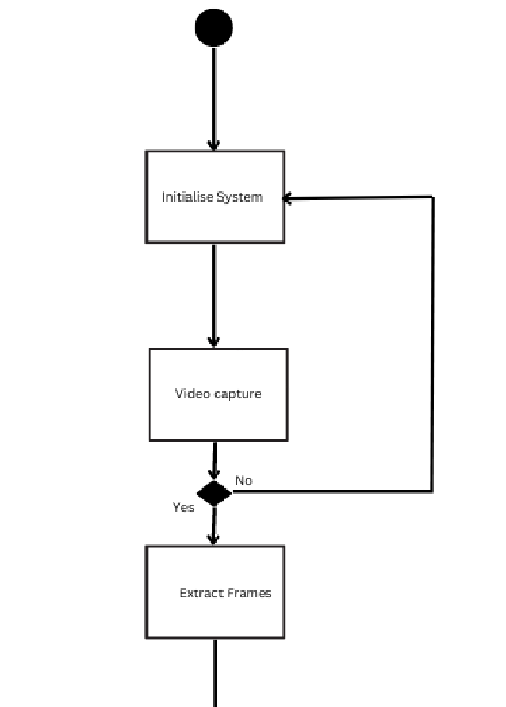
Activity Diagram

Slide 10
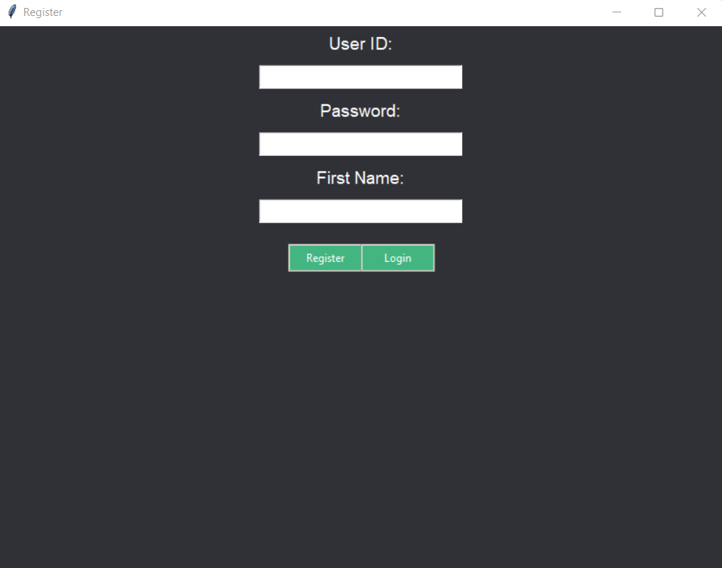
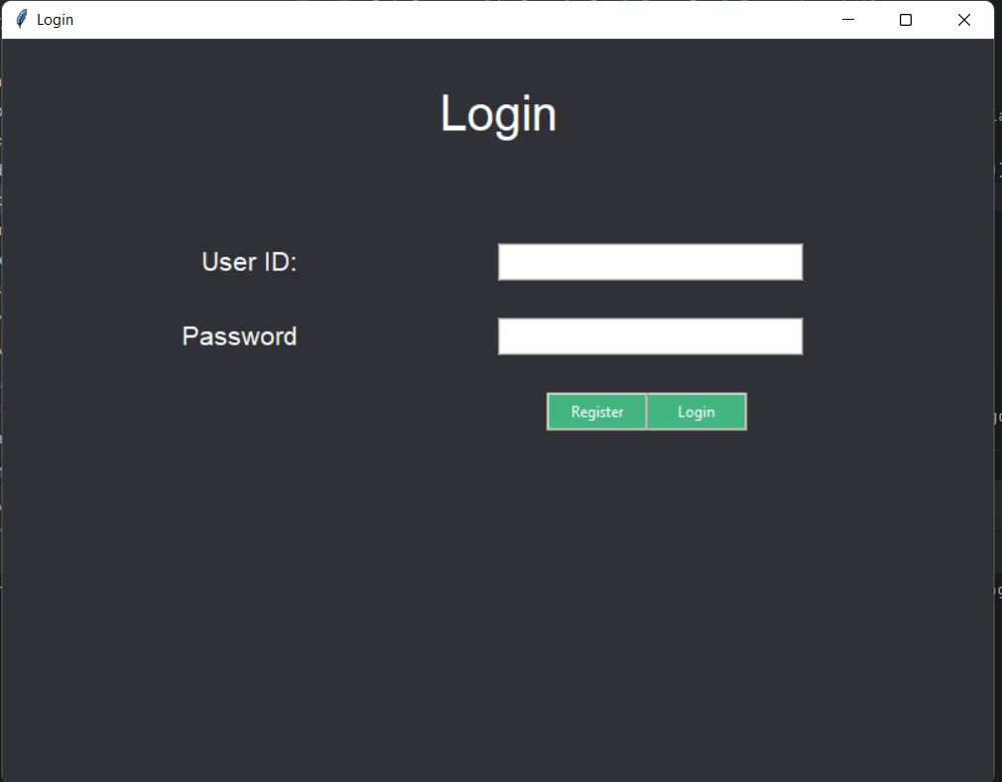
RESULTS

Slide 11
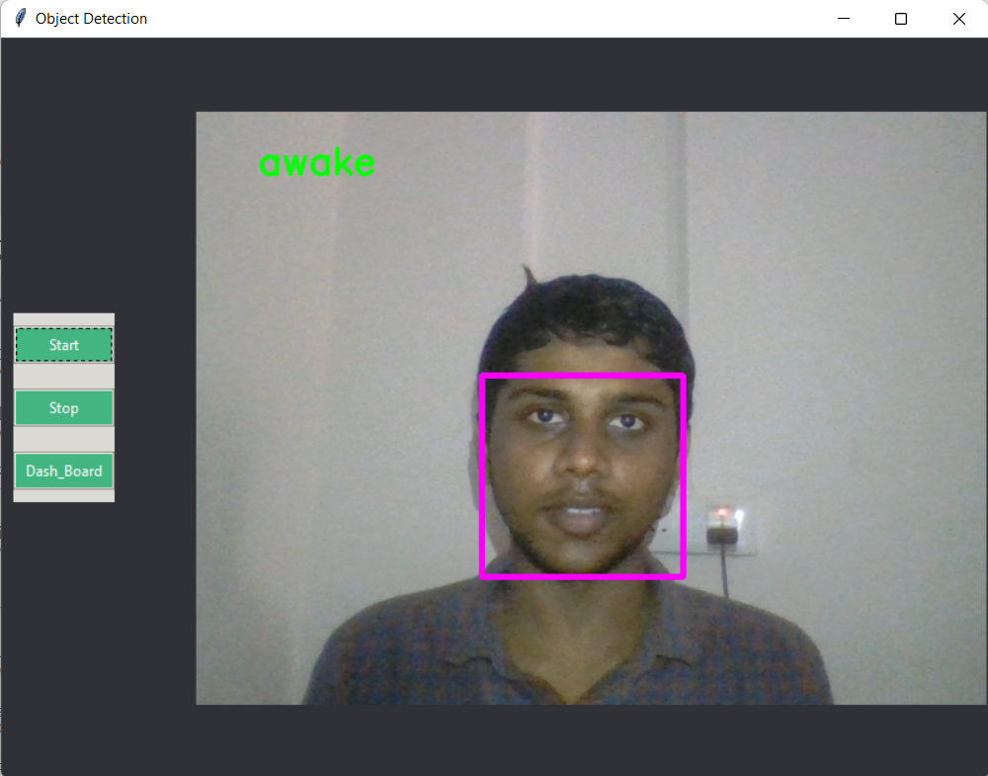
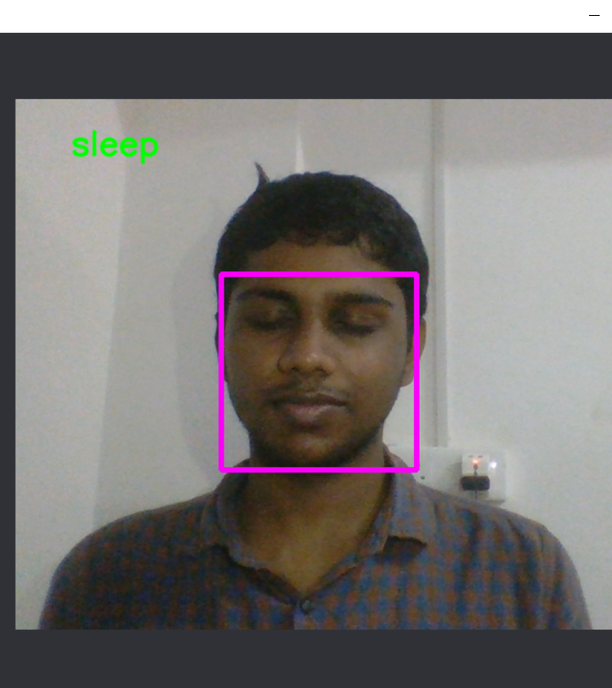
RESULTS

Slide 12
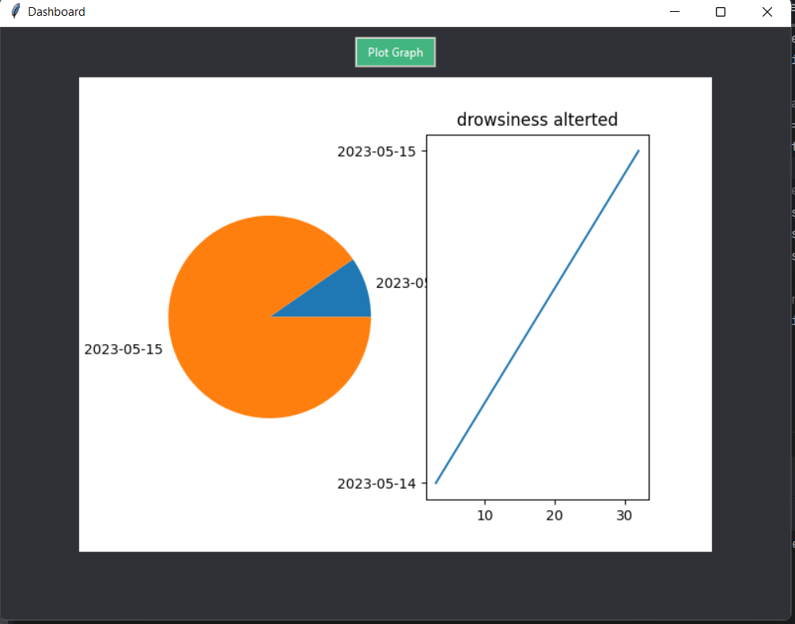

Slide 13
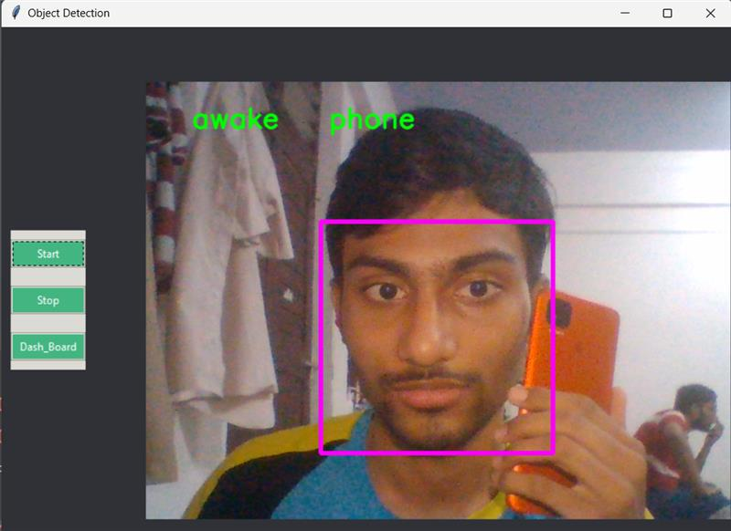
Using the vision-based approach the project is able to:
Detect the person’s drowsiness by the movement of his head and eyes.
Distinguish between normal eye blinks and drowsy eye blinks.
Detect whether the person is distracted using phone.

Slide 14
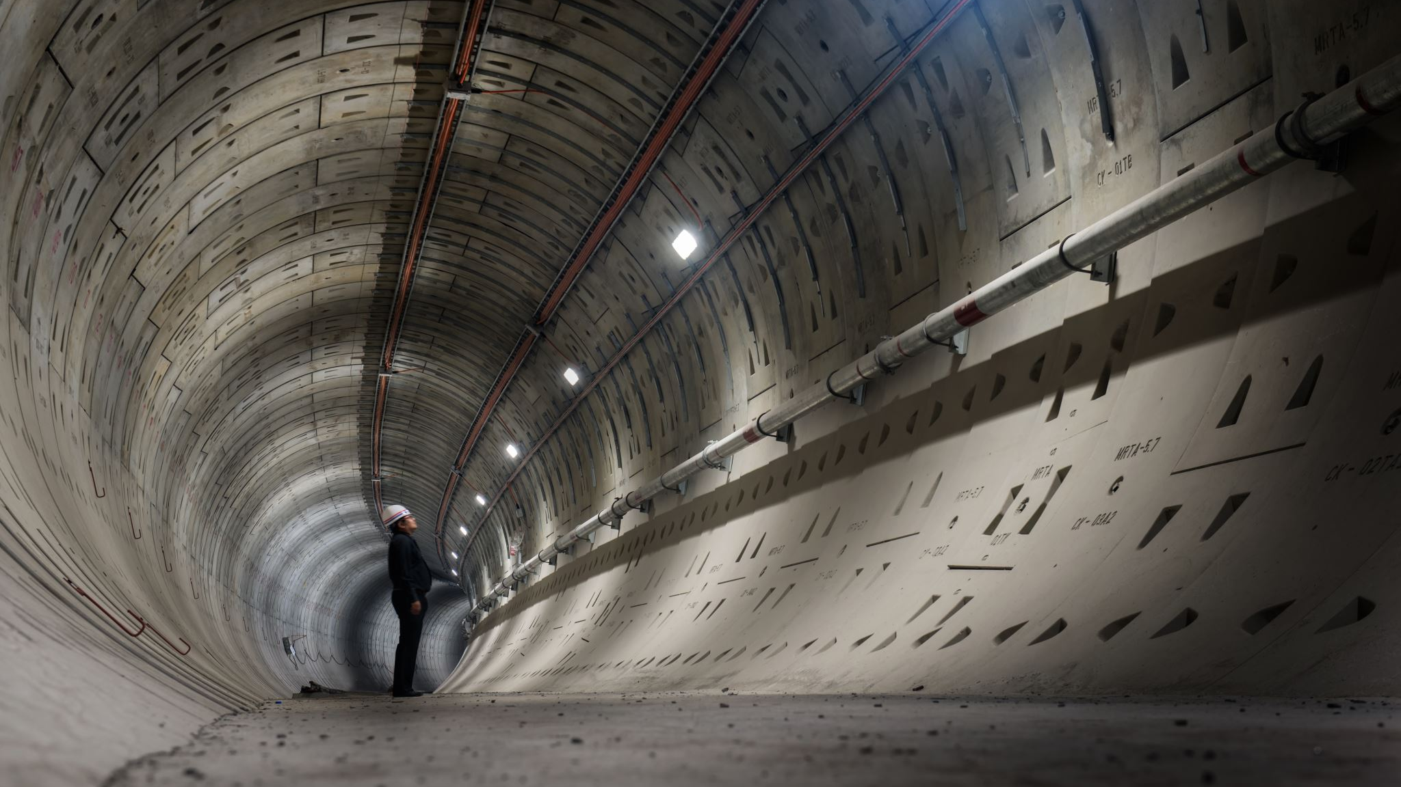
Conclusion
In order to, reduce the number of road accidents resulting from a driver fatigue, it is of great importance to introduce to the automotive industry a system that would effectively detect the first signs of a fatigue and notify the driver.
Along with the car safety system detecting drowsiness with the help of how the car is being driven like rapid steering , irregular and rapid braking or acceleration. This vision-based system with the right hardware can be more helpful in detecting the driver's drowsiness.
A system based on real-time face analysis can be one of the most effective approaches for detecting fatigue symptoms.
There are many problems associated with its design such as uneven illumination of a driver’s face or the selection of effective real-time data processing algorithms. Current technological advances in video recording and processing help reduce and even eliminate such problems

Slide 15

References
https://www.researchgate.net/publication/319464008_Driver_Drowsiness_Detection_Systems
https://www.ijert.org/drowsiness-detection-system
https://ieeexplore.ieee.org/document/6602353
http://www.iraj.in/journal/journal_file/journal_pdf/12-351-1496225771101-104.pdf
https://www.ncbi.nlm.nih.gov/pmc/articles/PMC3571819/

Slide 16


